Slide 1
Linear/Logistic Regression
Li Bofang

Slide 2
Previously on Our Seminar
For classification problem
  Step 1: Representation Learning
  Step 2: Classifier Training, which can be modelled as an optimization problem
from https://class.coursera.org/ntumlone-003/lecture

Slide 3
Outline
Examples of Regression Analysis
The Models
Loss Functions
Model Training
Prediction using the Model
Putting It All Together

Slide 4
Examples of Regression Analysis
Predicting the Credit Limit
  What’s the credit limit for each person (Regression)
  Can these people get 10,000 CNY credit (Classification)
age | 23
salary | 1, 000 yuan
Year in job | 2
current debt | 2, 000 yuan
?
age | 40
salary | 1, 000 yuan
Year in job | 20
current debt | 2, 000 yuan
age | 40
salary | 10, 000 yuan
Year in job | 20
current debt | 0 yuan
age | 60
salary | 5, 000 yuan
Year in job | 0
current debt | 20, 000 yuan

Slide 5
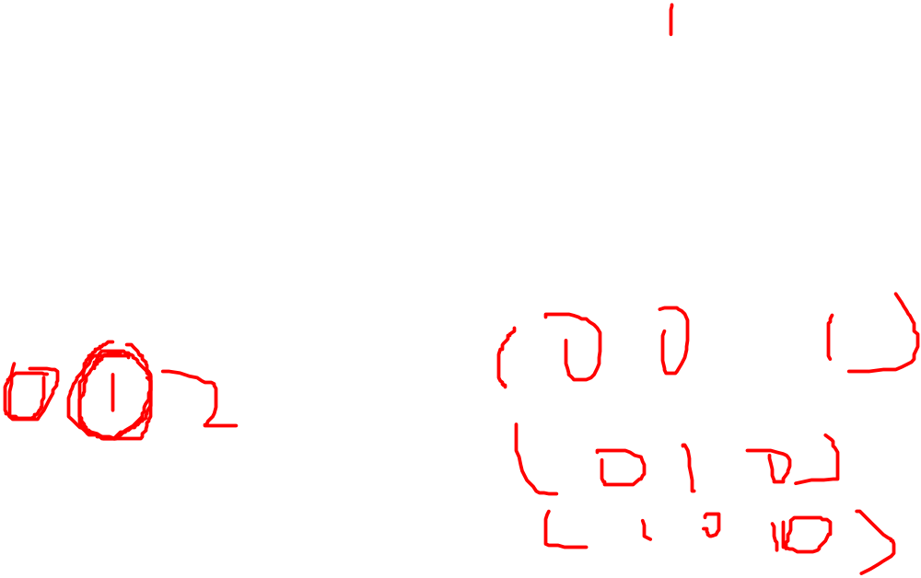
Problem Formulation
Inputs
  X=(age, salary, year in job, current debt)
Object Representation
  Regression
    Y=credit Limit
  Classification
    Y=1 or 0 (true or false)

Slide 6
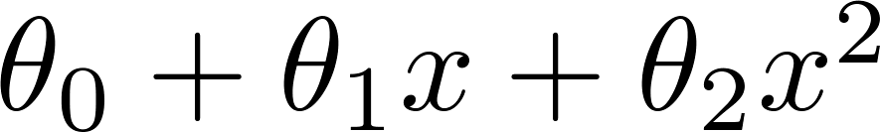
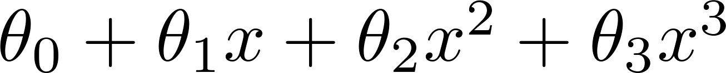
The Models
Linear and Polynomial regression

Slide 7
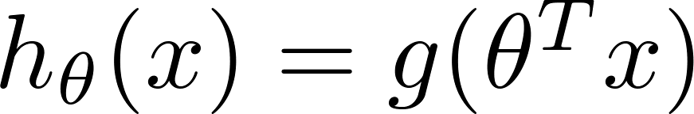
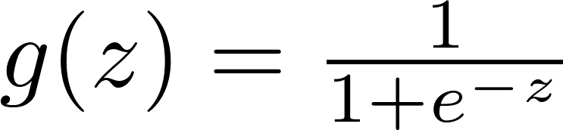
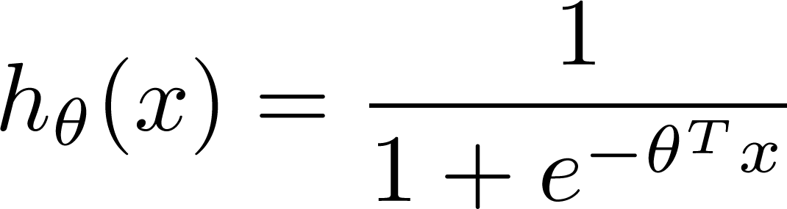
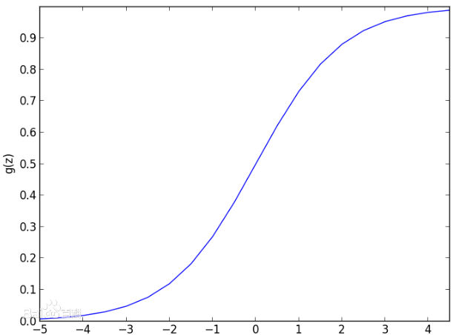
The Models
Logistic regression
  Mostly used for classification

Slide 8
Loss Functions
Loss Functions
Cost functions
Objective functions

Slide 9

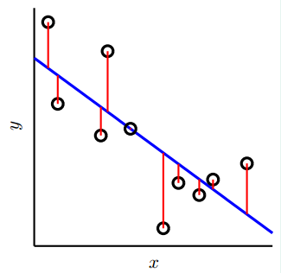
Loss Functions
Input:

Slide 10

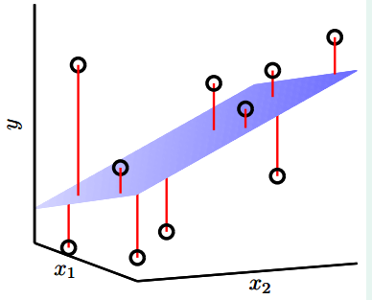
Loss Functions
Input:

Slide 11
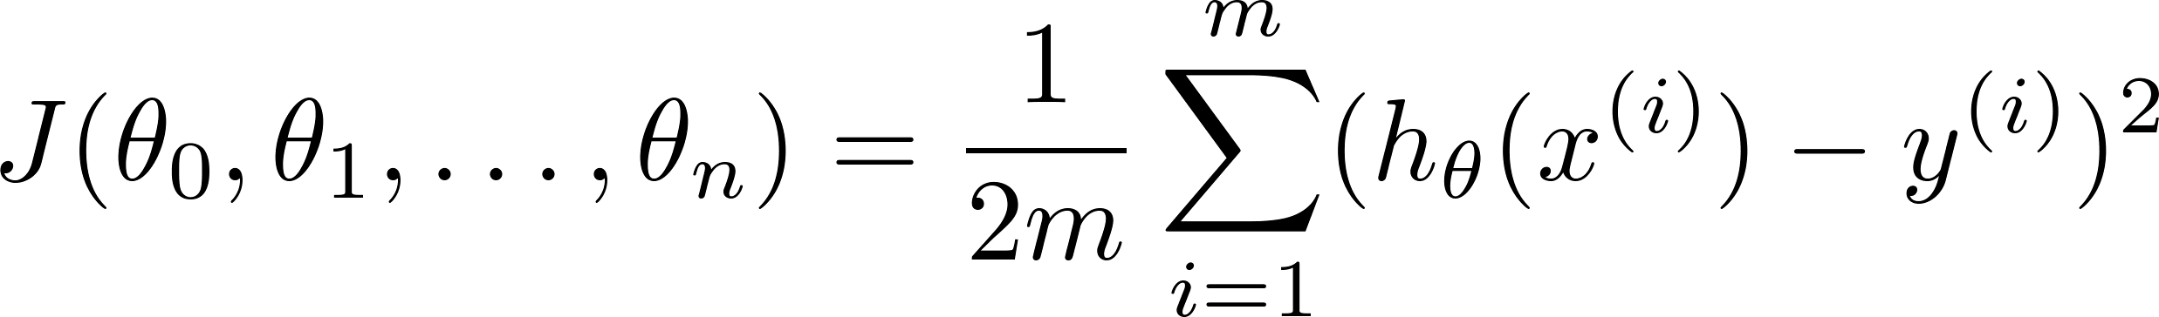
Loss Functions
L2 loss: for regression
for gradient

Slide 12
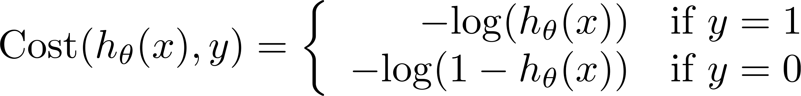
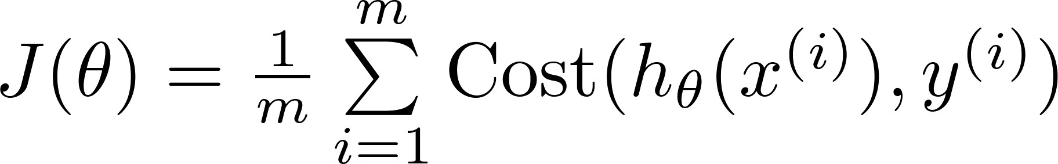
Loss Functions
log loss: for classification
for gradient

Slide 13
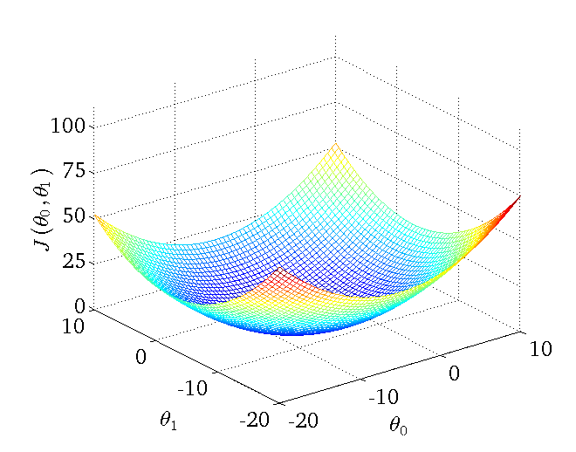
Loss Function
An example of L2 loss with two parameters
https://class.coursera.org/ml-005/lecture

Slide 14
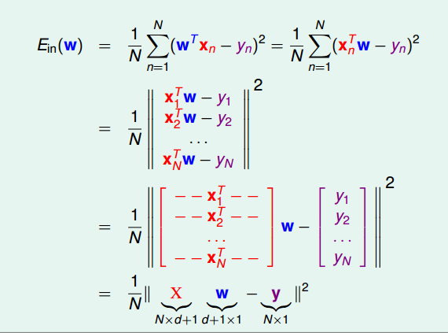
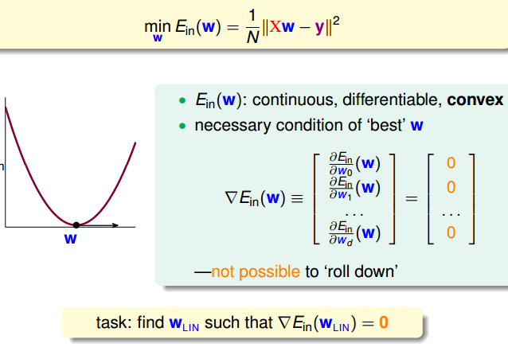
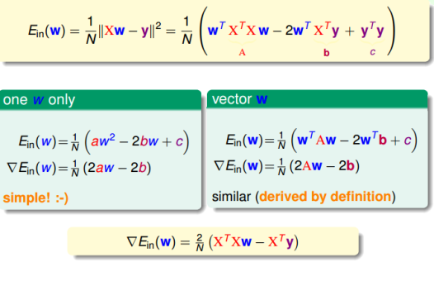
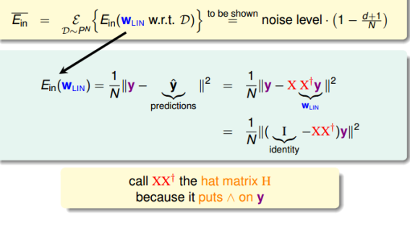
Model Training
The best solution: least squares method
  Only works for linear regression
  Most accurate
  Analytic solution
  Slow!
from https://class.coursera.org/ntumlone-003/lecture

Slide 15



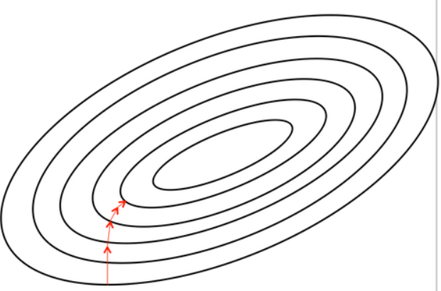

Previously on Our Seminar

Slide 16
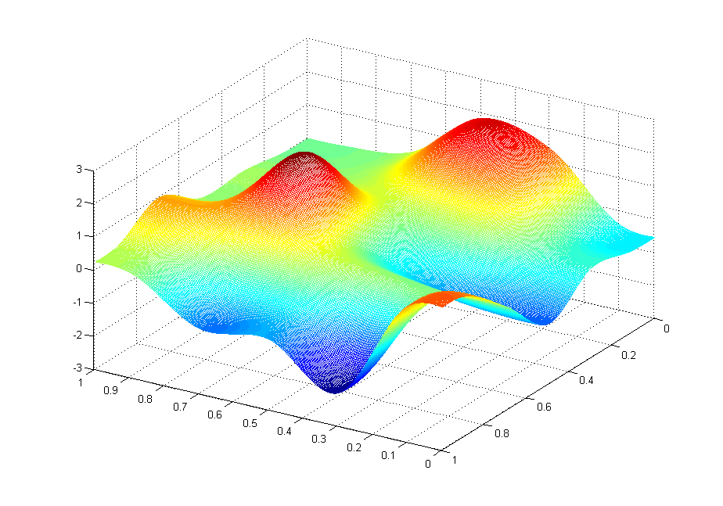
Model Training
Another Simpler Method: Gradient descent
  Simple
  Fast
  Not always accurate!

Slide 17
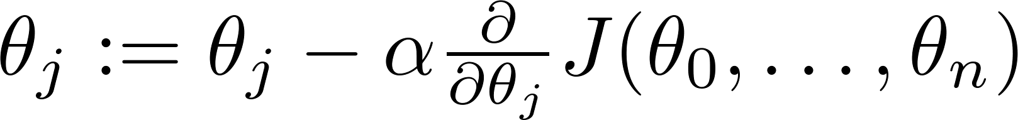
Gradient Descent
Repeat {
} Until {Convergence}
learning rate
gradient

Slide 18
Effect of Learning Rate
If alpha is very large
  Fast training
If alpha is very small
  More accurate
How to determine alpha
  Experience
  More advanced technique

Slide 19
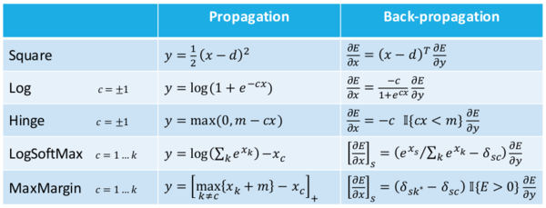
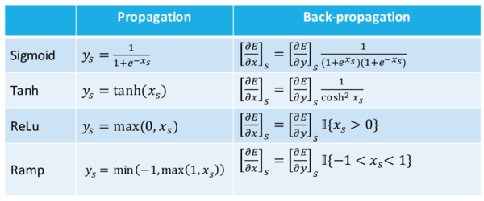
Model Training
Gradients
http://www.marekrei.com/blog/26-things-i-learned-in-the-deep-learning-summer-school/

Slide 20
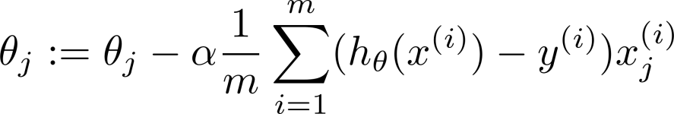
Model Training
Linear regression
→

Slide 21
Model Training
Logistic regression
→

Slide 22
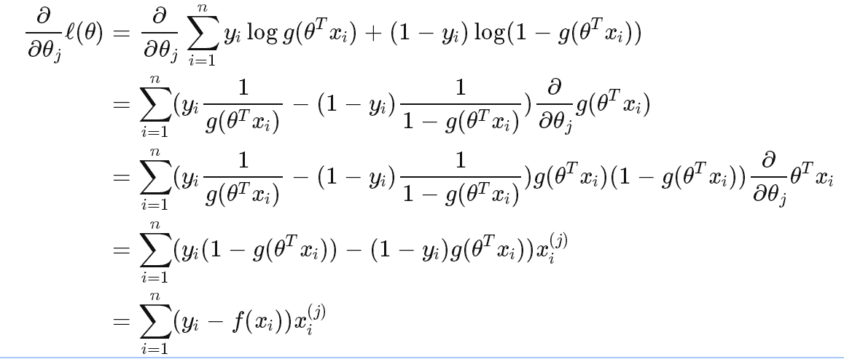
Model Training
Logistic regression
→

Slide 23
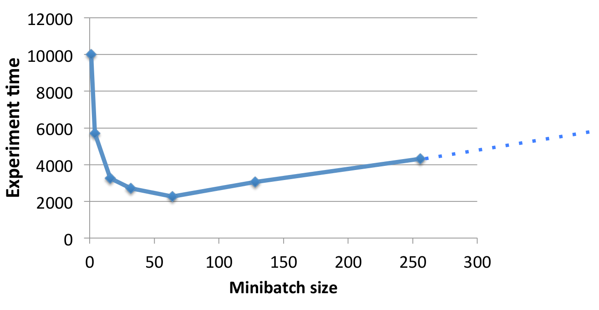
Model Training
Stochastic/batch gradient descent (SGD)
Each step of gradient descent uses a subset of all the training examples
Duration till convergence
http://www.marekrei.com/blog/26-things-i-learned-in-the-deep-learning-summer-school/

Slide 24

Illustration of Model Training
Credit Limit Problem
  dot for reject
  cross for accept
salary

Slide 25
Illustration of Model Training
Credit Limit Problem
  dot for reject
  cross for accept
salary

Slide 26
Illustration of Model Training
Credit Limit Problem
  dot for reject
  cross for accept
salary

Slide 27
Predicting using the Model
Credit Limit Problem
  dot for reject
  cross for accept
  Tri-angle for test
salary

Slide 28
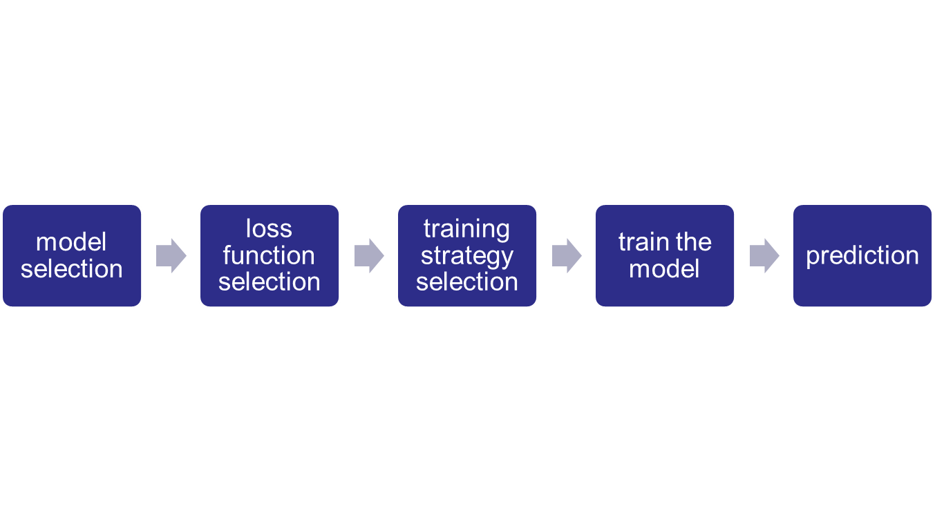
Putting It All Together

Slide 29
thanks

